Slide 1
Building Free Website
Tutorial

Slide 2
Examples of free hosting
Biz.nf (PHP, MySQL, WordPress, Joomla, Free .co.nf domain, No ads)
Free Hosting EU (Blog / Site builder, No ads, Free .eu.pn domain)
Wix.com (Easy Website builder: html5, Flash, mobile, blogs, etc.)
AwardSpace.net (PHP, MySQL, Email Sending, No Ads, Free subdomain)

Slide 3
Examples of free hosting
FreeHostia.com (PHP, MySQL, 1-click Scripts, No Ads, Free subdomain)
ByetHost.com (PHP, MySQL, PHPbb, SMF, Wiki, Free subdomain)
x10Hosting.com (Support cPanel, PHP, FTP, No ads, Free subdomain)
Yola.com (Visual website builder, add videos, photos, shopping cart)
Webs.com (Easy site builder, blog, forms, polls, Free subdomain)

Slide 4
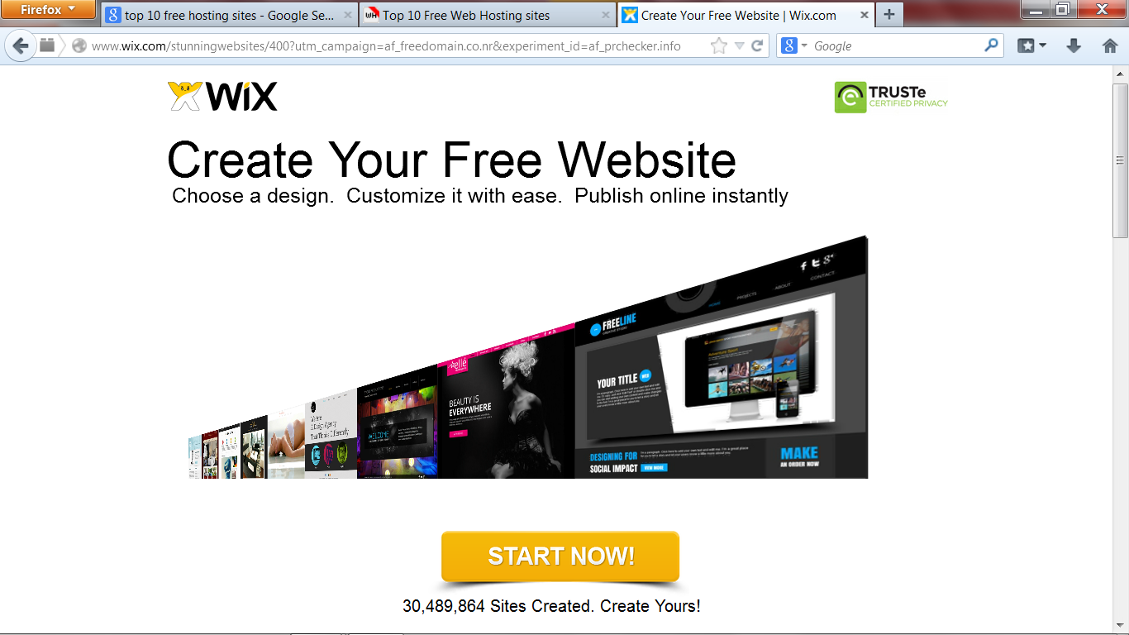
WiX.com) Select Hosting ( Example

Slide 5
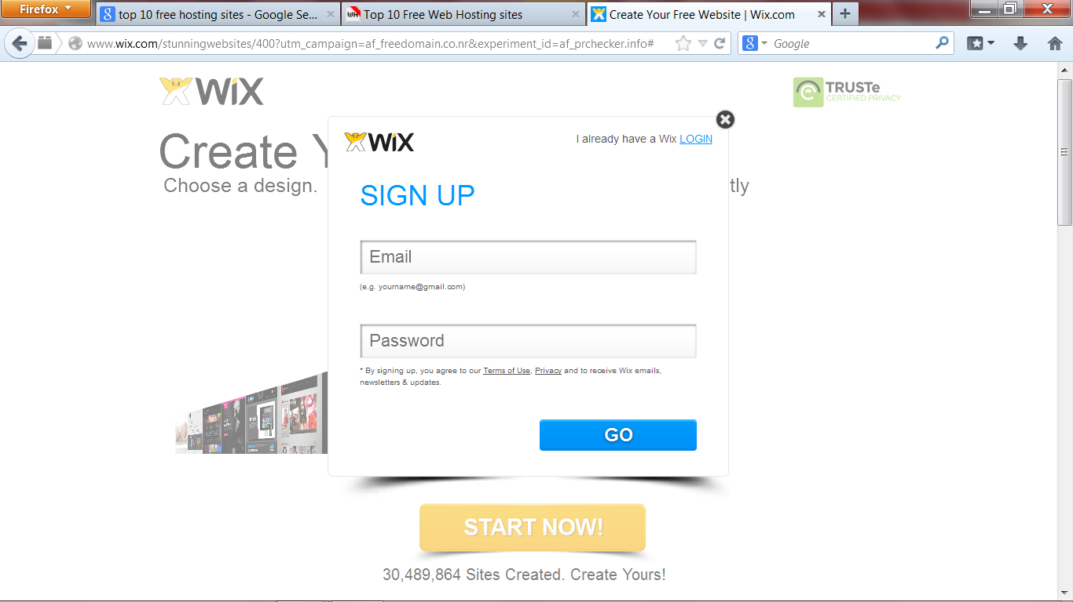
Login or Sign Up

Slide 6
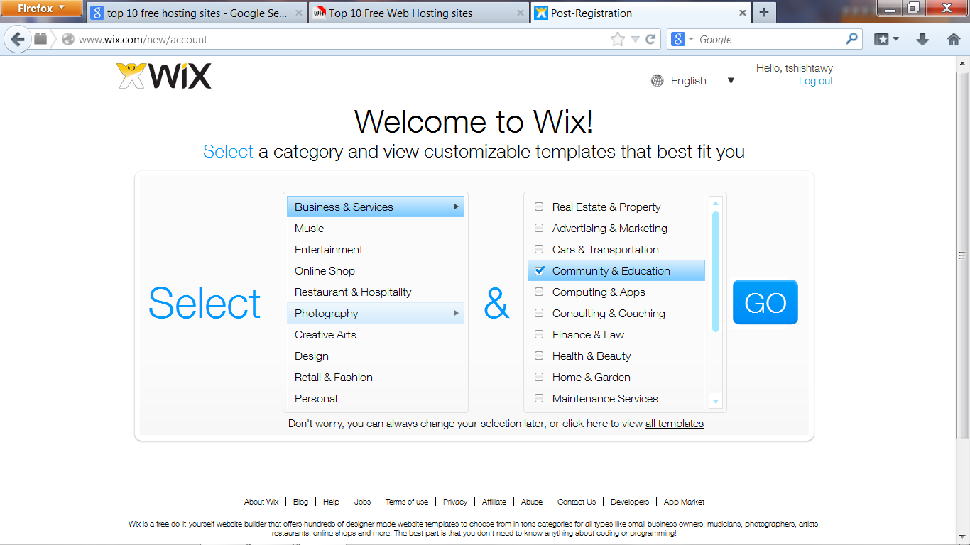
Select Category and Sub-Category and Click Go

Slide 7
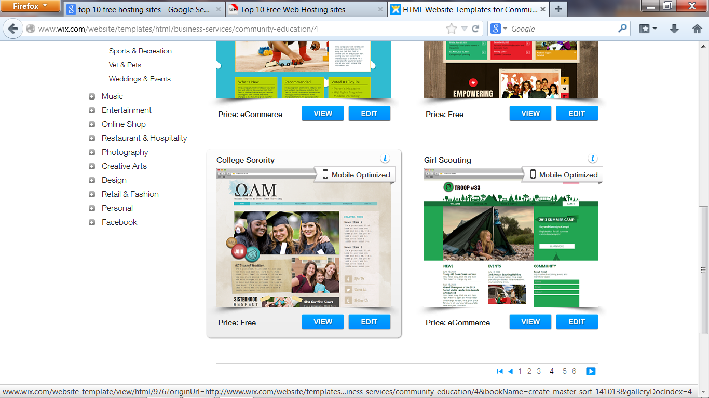
Select a Template (use next to find more…) then EDIT

Slide 8
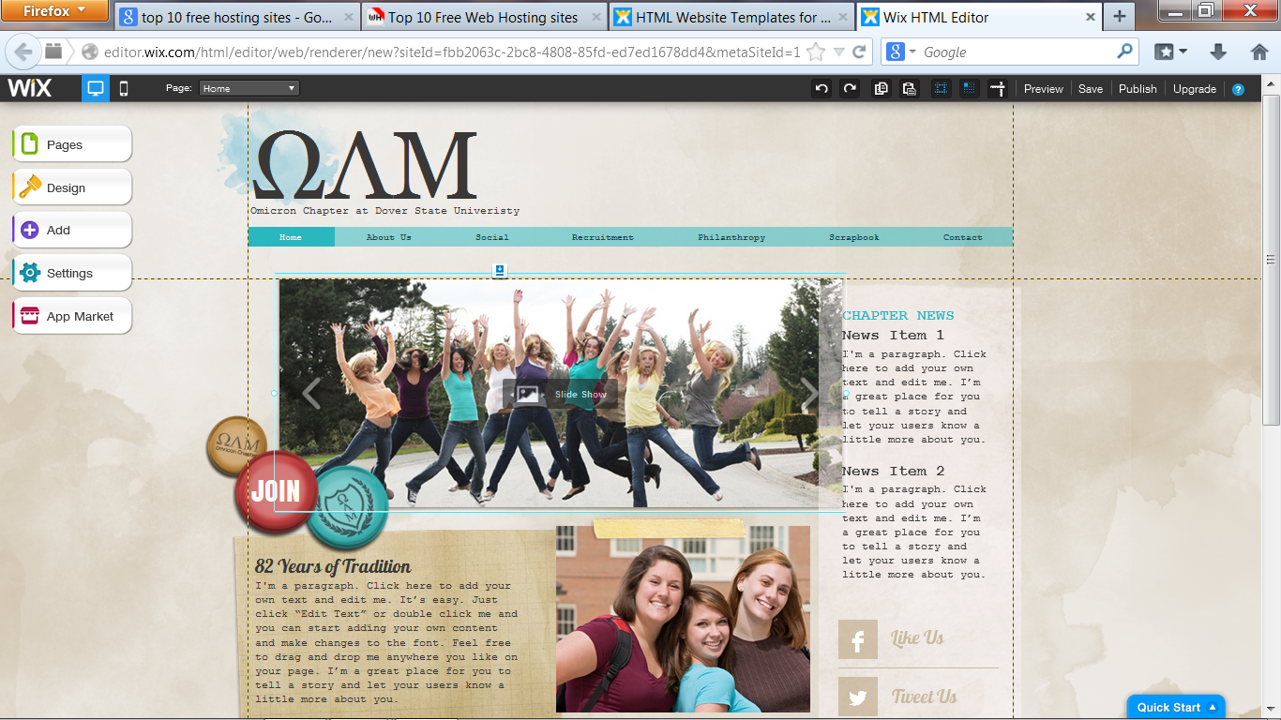
Template To be Modified, double click any item

Slide 9
An html Editor allows you to edit

Slide 10
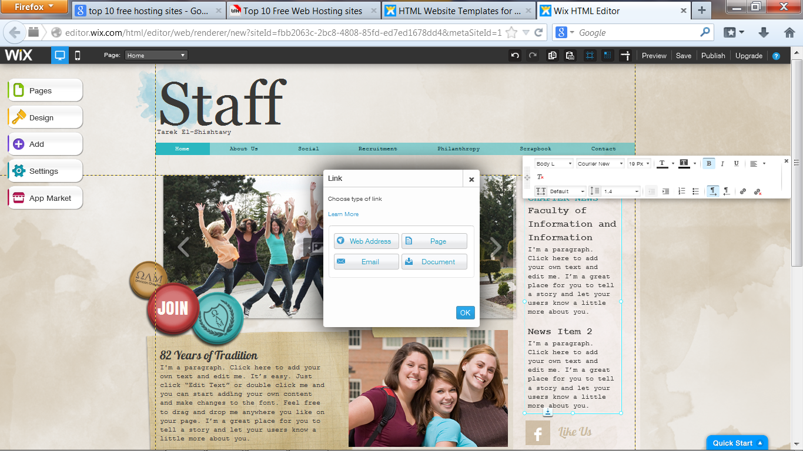
Adding Links

Slide 11
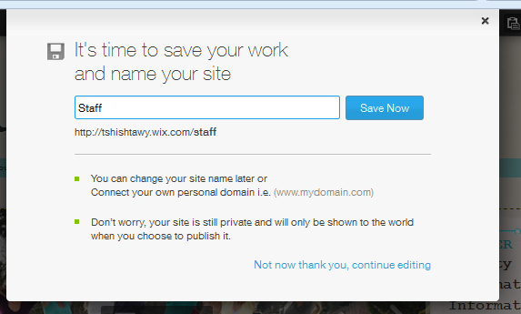
Don’t forget to save your work

